Slide 1
CHAPTER 9
Server-Side and PHP Slim
Building RESTful APIs as the backbone of cross-platform applications
SCSM2223 — Cross-Platform Application Development
Faculty of Computing • Universiti Teknologi Malaysia
Assoc. Prof. Dr Hishammuddin bin Asmuni

Slide 2
AT THE END OF THIS CHAPTER
Learning Objectives
C1
Define the role of the server-side and explain RESTful API design principles.
C2
Differentiate HTTP methods and standard status codes used in REST APIs.
C2
Describe the architecture and request lifecycle of the PHP Slim 4 framework.
C3
Set up a Slim project with Composer on Laragon and define basic routes.
C3
Read JSON request bodies, return JSON responses, and use route parameters.
C3
Apply middleware for cross-cutting concerns (CORS, logging, JSON parsing).
SCSM2223 • Chapter 9 • Server-Side and PHP Slim
2

Slide 3
RECAP — WEB ARCHITECTURE
Where the Server-Side Sits
Frontend
Backend
Database
Vue 3 SPA
PHP Slim 4 API
MySQL via PDO
Browser / Mobile
This Chapter
Chapter 10
HTTP requests with JSON bodies travel left → right; JSON responses travel right → left.
In this chapter we focus on the BACKEND: receiving requests, executing logic, and returning JSON.
SCSM2223 • Chapter 9 • Server-Side and PHP Slim
3

Slide 4
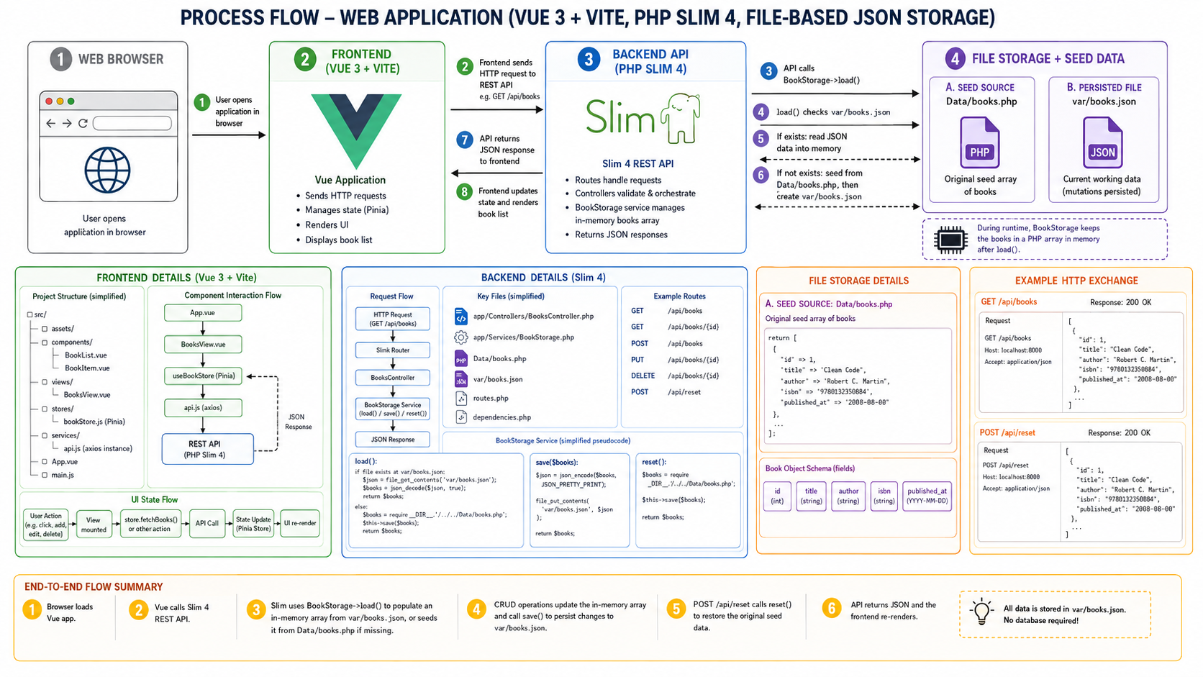

Slide 5
WHAT THE SERVER DOES
Role of the Server-Side
1
Receive Requests
2
Apply Business Logic
3
Talk to Data
Listens on HTTP, parses URL, headers, query, and body.
Validates input, enforces rules, computes results.
Reads/writes to database, file system, or other APIs.
4
Authenticate & Authorize
5
Return a Response
6
Cross-Cutting Concerns
Verifies who the user is and what they can do.
Sends back JSON, status code, and useful headers.
Logging, error handling, CORS, rate limiting.
SCSM2223 • Chapter 9 • Server-Side and PHP Slim
4

Slide 6
ARCHITECTURAL STYLE
What is REST?
REpresentational State Transfer
Coined by Roy Fielding (2000) — the dominant style for web APIs today.
Core idea
Key constraints
Stateless
Every request carries everything the server needs.
Uniform interface
Same set of HTTP verbs across every resource.
Client–server separation
Frontend and backend evolve independently.
Cacheable
Responses indicate whether they may be cached.
Everything is a resource (a noun, not an action).
Each resource has a stable URI such as /products/12.
Clients use standard HTTP verbs to manipulate it: GET, POST, PUT, DELETE.
The server returns a representation of the resource — typically JSON.
SCSM2223 • Chapter 9 • Server-Side and PHP Slim
5

Slide 7
VERBS THAT MATTER
HTTP Methods Used in REST
VERB
USE
PROPERTIES
EXAMPLE
GET
Retrieve a resource
Safe • Idempotent
GET /products
POST
Create a new resource
Not safe • Not idempotent
POST /products
PUT
Replace a resource
Idempotent
PUT /products/12
PATCH
Partial update
Not idempotent (typically)
PATCH /products/12
DELETE
Remove a resource
Idempotent
DELETE /products/12
SCSM2223 • Chapter 9 • Server-Side and PHP Slim
6

Slide 8
WHAT TO RETURN
Common HTTP Status Codes
2xx
Success
200
OK
GET / PUT / DELETE succeeded
201
Created
POST created a new resource
204
No Content
Success, but no body to return
4xx
Client error
400
Bad Request
Validation failed / malformed JSON
401
Unauthorized
Missing / invalid token
403
Forbidden
Authenticated but not allowed
404
Not Found
Resource doesn't exist
5xx
Server error
500
Internal Server Error
Unhandled exception in server code
503
Service Unavailable
Backend temporarily down
SCSM2223 • Chapter 9 • Server-Side and PHP Slim
7

Slide 9
RESOURCE NAMING
RESTful URI Patterns
Use plural nouns. Express hierarchy with nesting. Avoid verbs in URIs.
GOOD
BAD
GET /products
GET /getAllProducts
GET /products/12
GET /productById?id=12
POST /products
POST /createProduct
PUT /products/12
POST /updateProduct/12
DELETE /products/12
GET /deleteProduct/12
GET /vendors/3/menu-items
GET /listMenuFor?vendor=3
SCSM2223 • Chapter 9 • Server-Side and PHP Slim
8

Slide 10
OVER THE WIRE
Anatomy of an HTTP Request & Response
REQUEST →
← RESPONSE
POST /api/products HTTP/1.1
Host: localhost:8000
Authorization: Bearer eyJhbGc...
Content-Type: application/json
{
"name": "Notebook",
"price": 12.50
}
HTTP/1.1 201 Created
Content-Type: application/json
Location: /api/products/15
{
"id": 15,
"name": "Notebook",
"price": 12.50,
"message": "Product created"
}
Three things to inspect on every call: STATUS CODE, HEADERS, and BODY.
SCSM2223 • Chapter 9 • Server-Side and PHP Slim
9

Slide 11
PAYLOAD FORMAT
JSON — JavaScript Object Notation
Why JSON?
{
"id": 12,
"name": "Hashim",
"isActive": true,
"roles": ["admin", "editor"],
"address": {
"city": "Skudai",
"zip": "81310"
}
}
Lightweight — text only, no schema overhead.
Language independent — parsed by every language.
Maps cleanly to JS objects, PHP assoc arrays, and Vue reactive state.
Native browser support via JSON.parse / JSON.stringify.
Standard Content-Type: application/json.
SCSM2223 • Chapter 9 • Server-Side and PHP Slim
10

Slide 12
FRAMEWORK INTRO
What is the PHP Slim Framework?
"Slim is a PHP micro framework that helps you quickly write simple yet powerful web applications and APIs."
— slimframework.com
1
2
3
4
Micro
PSR-7 / PSR-15
Routing-first
Plays well with others
Tiny core, ~few KB. Bring only what you need.
Standard request/response and middleware contracts.
Powerful route patterns with parameters and groups.
Add Eloquent, Twig, JWT — your choice.
SCSM2223 • Chapter 9 • Server-Side and PHP Slim
11

Slide 13
WHY SLIM FOR THIS COURSE
Slim vs Alternatives
ASPECT | Raw PHP | Slim 4 (this course) | Laravel / Symfony
Footprint | Tiny | Small (a few MB) | Large (full framework)
Routing | Manual switch on URL | Built-in router | Built-in router
Middleware | Custom | PSR-15 standard | Pipeline
Learning curve | Low entry, scales badly | Low entry, scales well | Steep but feature-rich
Best for | Tiny scripts | REST APIs / micro-services | Full web apps + admin panels
Slim hits the sweet spot for our course: REST API focus, manageable scope for a 4-person team in 7 weeks.
SCSM2223 • Chapter 9 • Server-Side and PHP Slim
12

Slide 14
REQUEST LIFECYCLE
How a Slim Request Flows
1
Browser sends request
Mental model:
2
Web server (Apache/Nginx) hits public/index.php
Request → M1 → M2 → Route Handler
Response ← M2 ← M1
3
Slim app parses request → PSR-7 object
4
Middleware stack runs (auth, CORS, logging…)
Middleware wraps the handler like an onion — each layer can read the request, mutate the response, or short-circuit (e.g., reject unauthenticated calls).
5
Router dispatches to matching handler
6
Handler builds PSR-7 response
7
Middleware unwraps in reverse
8
Web server returns response to browser
SCSM2223 • Chapter 9 • Server-Side and PHP Slim
13

Slide 15
PROJECT SETUP
Installing Slim with Composer
Use Laragon's built-in Composer (or install via getcomposer.org). All commands are run from the project root.
# 1. Create the project folder inside laragon\www
cd C:\laragon\www
mkdir books-api && cd books-api
# 2. Initialise Composer
composer init --name="utm/books-api" --no-interaction
# 3. Install Slim 4 + the official PSR-7 implementation
composer require slim/slim:"4.*" slim/psr7
# 4. (Optional but recommended) PHP-DI for dependency injection
composer require php-di/php-di
# 5. Verify
composer show | findstr slim
SCSM2223 • Chapter 9 • Server-Side and PHP Slim
14

Slide 16
FOLDER LAYOUT
Recommended Slim Project Structure
books-api/
├── public/
│ ├── index.php ← entry point (Apache/Nginx points here)
│ └── .htaccess ← rewrite rules for clean URLs
├── src/
│ ├── routes.php ← all route definitions
│ ├── Controllers/
│ │ └── BookController.php
│ ├── Middleware/
│ │ └── JsonBodyParser.php
│ └── Data/
│ └── books.php ← seed data (Chapter 9, no DB yet)
├── vendor/ ← installed by Composer (don't edit)
├── composer.json
└── README.md
SCSM2223 • Chapter 9 • Server-Side and PHP Slim
15

Slide 17
FIRST APP
Hello World in Slim 4
<?php // public/index.php
use Psr\Http\Message\ResponseInterface as Response;
use Psr\Http\Message\ServerRequestInterface as Request;
use Slim\Factory\AppFactory;
require __DIR__ . '/../vendor/autoload.php';
$app = AppFactory::create();
$app->addRoutingMiddleware();
$app->addErrorMiddleware(true, true, true);
$app->get('/', function (Request $req, Response $res) {
$res->getBody()->write('Hello, Slim!');
return $res;
});
$app->run();
Reading the code
AppFactory::create()
Builds the Slim app.
addRoutingMiddleware()
Enables route dispatch.
addErrorMiddleware(...)
Catches exceptions, returns proper errors.
$app->get('/', ...)
Defines a GET route at the root path.
$app->run()
Starts the request lifecycle.
SCSM2223 • Chapter 9 • Server-Side and PHP Slim
16

Slide 18
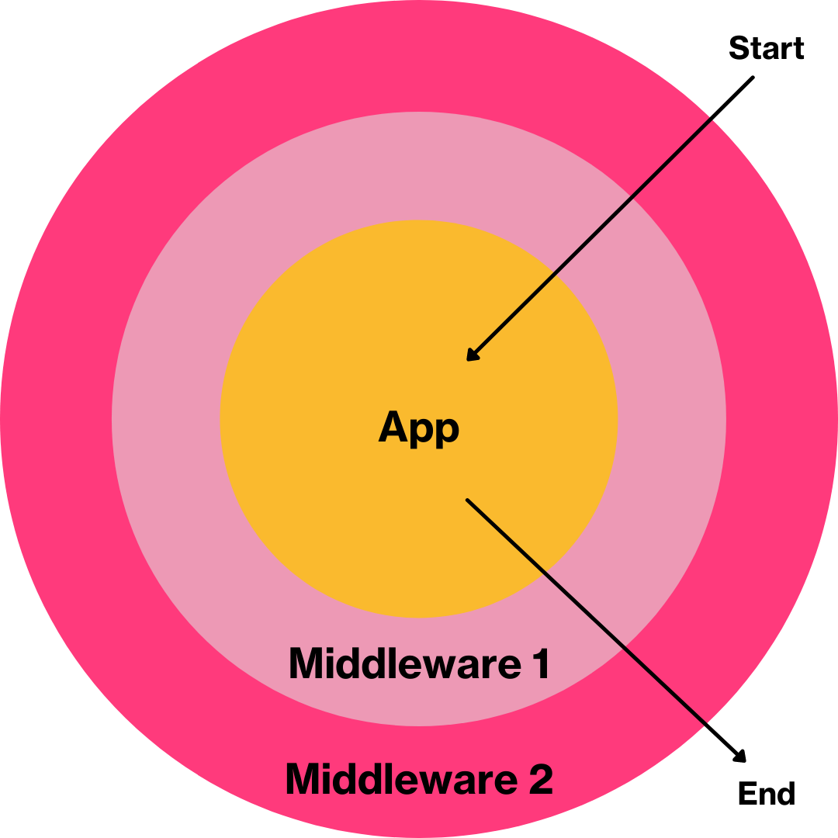
In a Slim application, each route invokes a callback function that returns an HTTP response object. The code above begins by bringing in all the PSR-7 components that the app needs. It then instantiates the app and attaches two middleware classes to it.
The Slim middleware architecture is derived from the PSR-15 middleware interface. This is a series of concentric layers that encircle the core application, such that the last middleware added will be the first to be executed.
This concentric architecture means that when the Slim application is started, the request object passes through a series of middleware classes, or layers, working from the outside inward. The request enters the outermost middleware, then moves on to the next outermost middleware, continuing until it reaches the application.
For this reason, to catch any errors in the application, you call $app->addErrorMiddleware(true, true, true) last, otherwise any errors thrown from the other middlewares will not be caught.
Once the request object reaches the Slim application, the relevant route is dispatched, resulting in a response object exiting the concentric layers from the inside out. When the object passes the outermost middleware, it is turned into a raw HTTP response and then returned to the client.

Slide 19
ROUTING IN SLIM
Route Patterns You'll Use Daily
// Static path
$app->get('/about', fn(Request $r, Response $s) => $s->getBody()->write('about') ?: $s);
// Path parameter (id is captured)
$app->get('/books/{id}', function (Request $r, Response $s, array $args) {
$id = (int)$args['id'];
$s->getBody()->write(json_encode(['id' => $id]));
return $s->withHeader('Content-Type', 'application/json');
});
// Multiple verbs on the same path
$app->post('/books', BookController::class . ':create');
$app->put('/books/{id}', BookController::class . ':update');
$app->delete('/books/{id}', BookController::class . ':delete');
// Route group with shared prefix
$app->group('/api', function ($g) {
$g->get('/books', BookController::class . ':index');
$g->get('/books/{id}', BookController::class . ':show');
});
SCSM2223 • Chapter 9 • Server-Side and PHP Slim
17

Slide 20
REQUEST OBJECT
Reading Inputs from the Request
// 1. Path parameters — third callback argument
$app->get('/books/{id}', function (Request $r, Response $s, array $args) {
$id = (int)$args['id']; // /books/12 → 12
return $s;
});
// 2. Query string — ?q=harry&limit=10
$app->get('/books', function (Request $r, Response $s) {
$params = $r->getQueryParams();
$q = $params['q'] ?? '';
$limit = (int)($params['limit'] ?? 20);
});
// 3. JSON body for POST/PUT
$app->post('/books', function (Request $r, Response $s) {
$data = json_decode((string)$r->getBody(), true); // assoc array
$title = $data['title'] ?? null;
});
// 4. Headers
$auth = $r->getHeaderLine('Authorization'); // 'Bearer eyJhbGc...'
SCSM2223 • Chapter 9 • Server-Side and PHP Slim
18

Slide 21
RESPONSE OBJECT
Building a JSON Response
// Convention: always return JSON + correct status code.
function jsonResponse(Response $res, $data, int $status = 200): Response {
$res->getBody()->write(json_encode($data));
return $res
->withHeader('Content-Type', 'application/json')
->withStatus($status);
}
$app->post('/books', function (Request $r, Response $s) {
$data = json_decode((string)$r->getBody(), true);
if (empty($data['title'])) {
return jsonResponse($s, ['error' => 'title is required'], 400);
}
$book = ['id' => 99, 'title' => $data['title']];
return jsonResponse($s, $book, 201)
->withHeader('Location', '/api/books/' . $book['id']);
});
// Tip: Slim's PSR-7 response object is IMMUTABLE.
// withHeader / withStatus return a NEW object — always return it.
SCSM2223 • Chapter 9 • Server-Side and PHP Slim
19

Slide 22
MIDDLEWARE
Middleware: Cross-Cutting Logic
// Custom middleware — parses JSON bodies into the request
$app->add(function (Request $req, $handler) {
if (str_starts_with($req->getHeaderLine('Content-Type'), 'application/json')) {
$body = (string)$req->getBody();
$req = $req->withParsedBody(json_decode($body, true) ?? []);
}
return $handler->handle($req); // pass on to next layer
});
// CORS — let a Vue dev server on :5173 call our API
$app->add(function (Request $req, $handler) {
$res = $handler->handle($req);
return $res
->withHeader('Access-Control-Allow-Origin', '*')
->withHeader('Access-Control-Allow-Headers', 'Content-Type, Authorization')
->withHeader('Access-Control-Allow-Methods', 'GET, POST, PUT, DELETE, OPTIONS');
});
Common uses
JSON body parsing
CORS headers
Authentication (JWT)
Logging / timing
Rate limiting
Error formatting
SCSM2223 • Chapter 9 • Server-Side and PHP Slim
20

Slide 23
Worked Example — BookController
PUTTING IT ALL TOGETHER
<?php // src/Controllers/BookController.php
namespace App\Controllers;
use Psr\Http\Message\ResponseInterface as Response;
use Psr\Http\Message\ServerRequestInterface as Request;
class BookController {
private static array $books = [
['id'=>1,'title'=>'Clean Code', 'author'=>'Robert C. Martin'],
['id'=>2,'title'=>'Eloquent JavaScript','author'=>'Marijn Haverbeke'],
];
public function index(Request $r, Response $s): Response {
return $this->json($s, self::$books);
}
public function show(Request $r, Response $s, array $args): Response {
$id = (int)$args['id'];
$found = array_values(array_filter(self::$books, fn($b)=>$b['id']===$id))[0] ?? null;
return $found ? $this->json($s, $found)
: $this->json($s, ['error'=>'not found'], 404);
}
private function json(Response $s, $d, int $code=200): Response {
$s->getBody()->write(json_encode($d));
return $s->withHeader('Content-Type','application/json')->withStatus($code);
}
}
SCSM2223 • Chapter 9 • Server-Side and PHP Slim
21

Slide 24
WATCH OUT
Common Pitfalls & Best Practices
✗
Forgetting to RETURN the response
✗
Wrong Content-Type
withHeader/withStatus are immutable — always return the new object.
Use application/json on every JSON response.
✗
Stringifying twice
✓
Always validate inputs
json_encode($data) once; don't wrap with another json_encode.
Treat anything from the client as hostile until proven otherwise.
✓
Use route groups
✓
Return correct status codes
Group /api routes once, apply auth middleware to the group.
201 on create, 204 on delete, 400 / 401 / 404 / 500 where appropriate.
SCSM2223 • Chapter 9 • Server-Side and PHP Slim
22

Slide 25
WHAT YOU NOW KNOW
Summary — Chapter 9
Server-side
Validates input, enforces logic, talks to data, returns JSON.
REST
Resources are nouns; HTTP verbs act on them; statelessness wins.
HTTP
Know the verbs (GET/POST/PUT/PATCH/DELETE) and the codes (2xx/4xx/5xx).
Slim 4
Micro framework on PSR-7/15; routes + handlers + middleware.
Practice
You can scaffold, define routes, parse JSON, and return responses.
SCSM2223 • Chapter 9 • Server-Side and PHP Slim
23

Slide 26
Next Up
Lab Hands-On — Build a Books REST API
Five GET / POST / PUT / DELETE endpoints in PHP Slim 4 — running on Laragon, tested with curl/Postman.
Set up Laragon + Composer
Scaffold Slim 4 project
Define five RESTful routes
Test each with Postman / curl
Bonus: add a custom middleware
24

